Slide 1
Proto-cell: status and plans
Collaboration meeting 21.02.2024
Axel Brunold

Slide 2
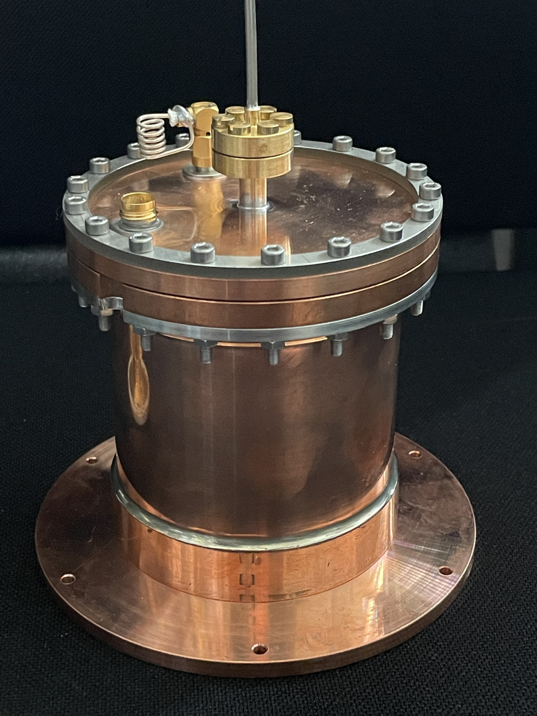
The Proto-cell
fill line/capillary
level meter
Volume of 280ml
Equipped with a He level meter
12 pins for electrical connections
indium seal
detector wiring

Slide 3
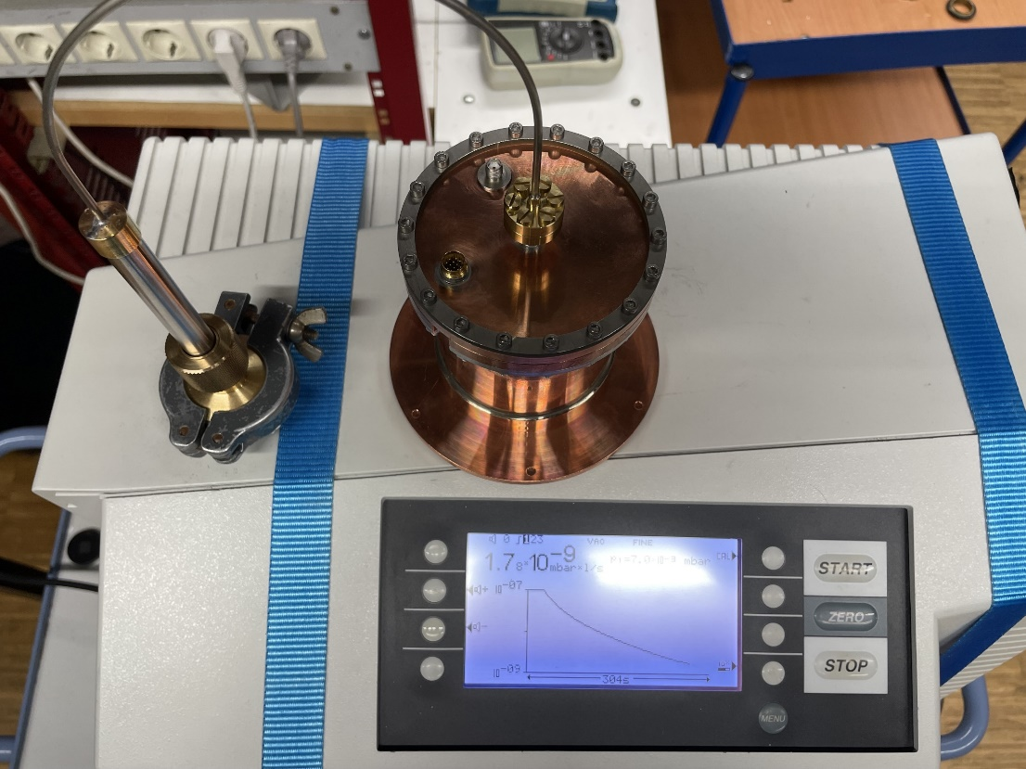
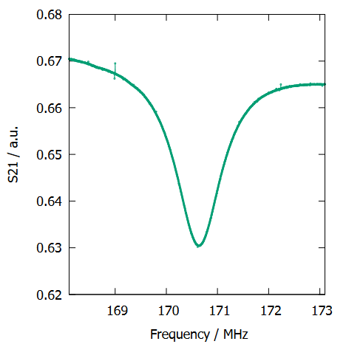
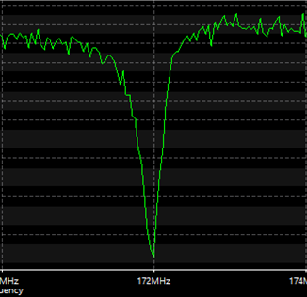
First cryo test run (happening right now)
“Empty“ Proto-cell
Goals:
Verify that the cell is superfluid leak tight
Check functionality of the level meter
Air
Vakuum

Slide 4
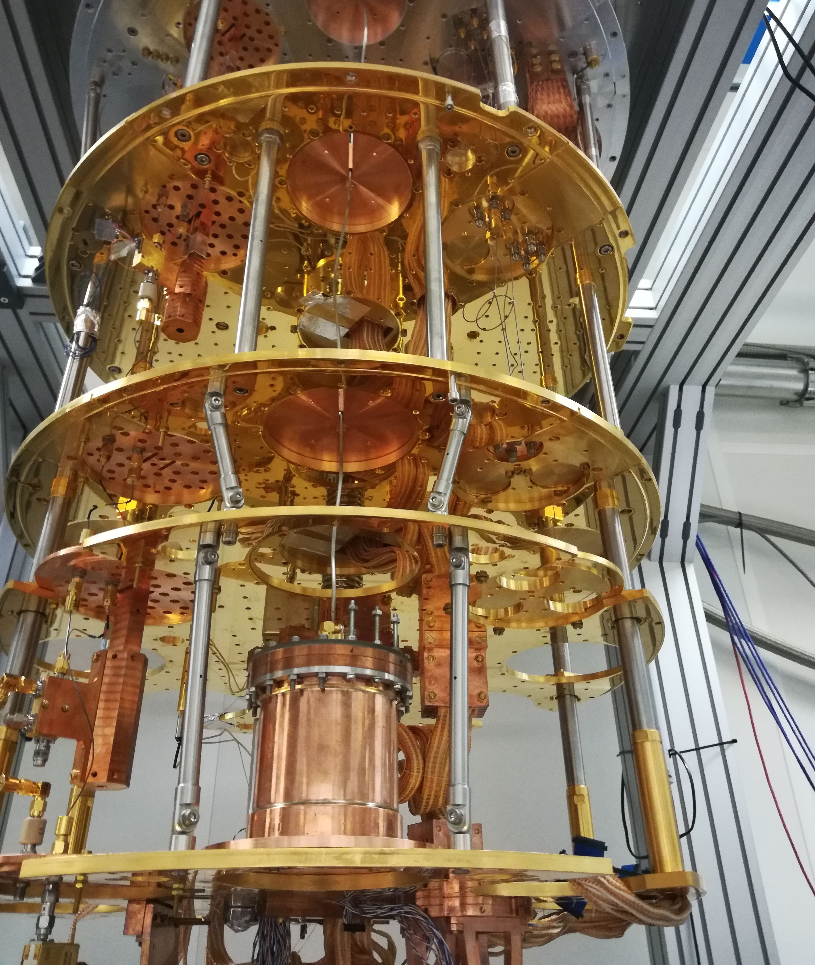

Slide 5
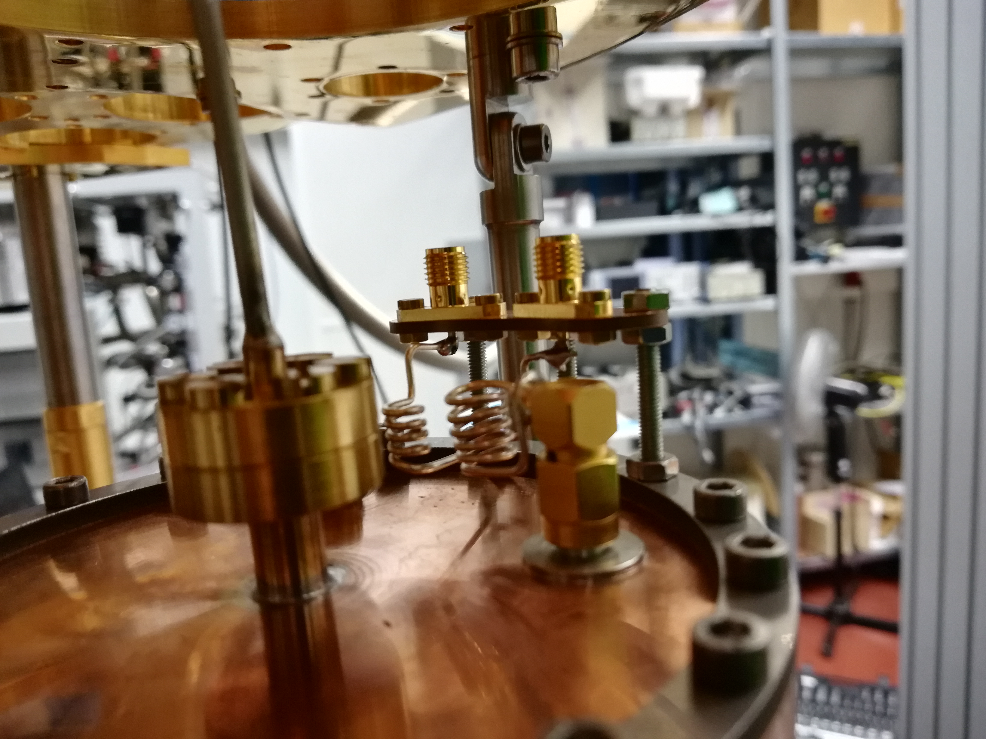

Slide 6
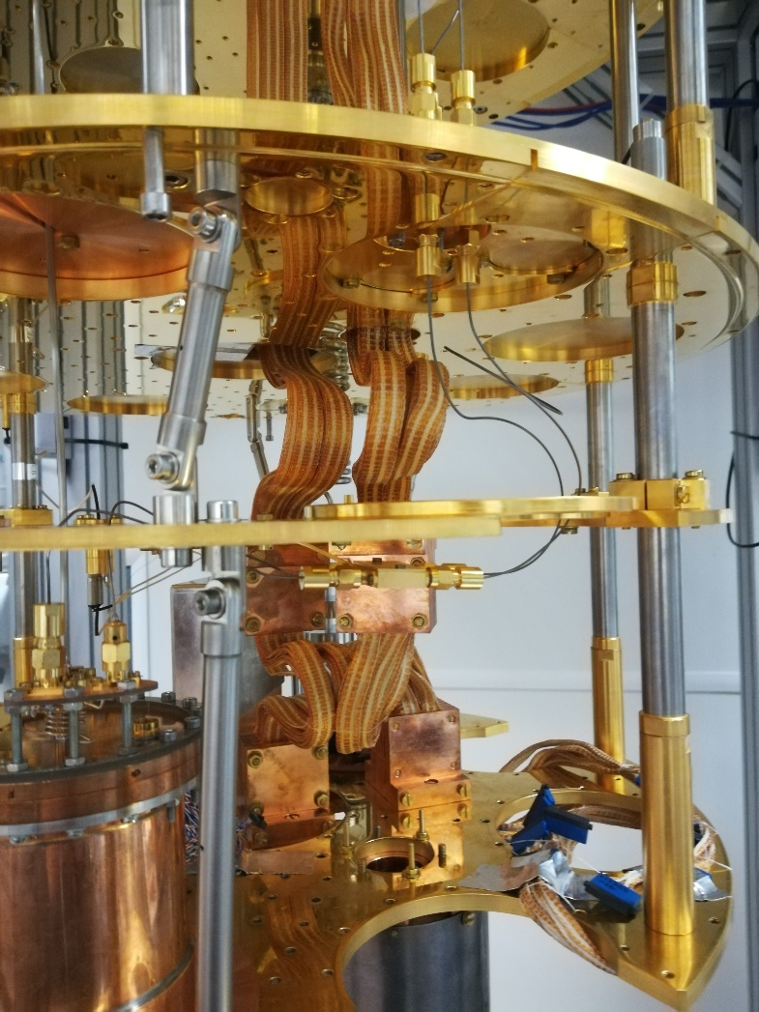

Slide 7
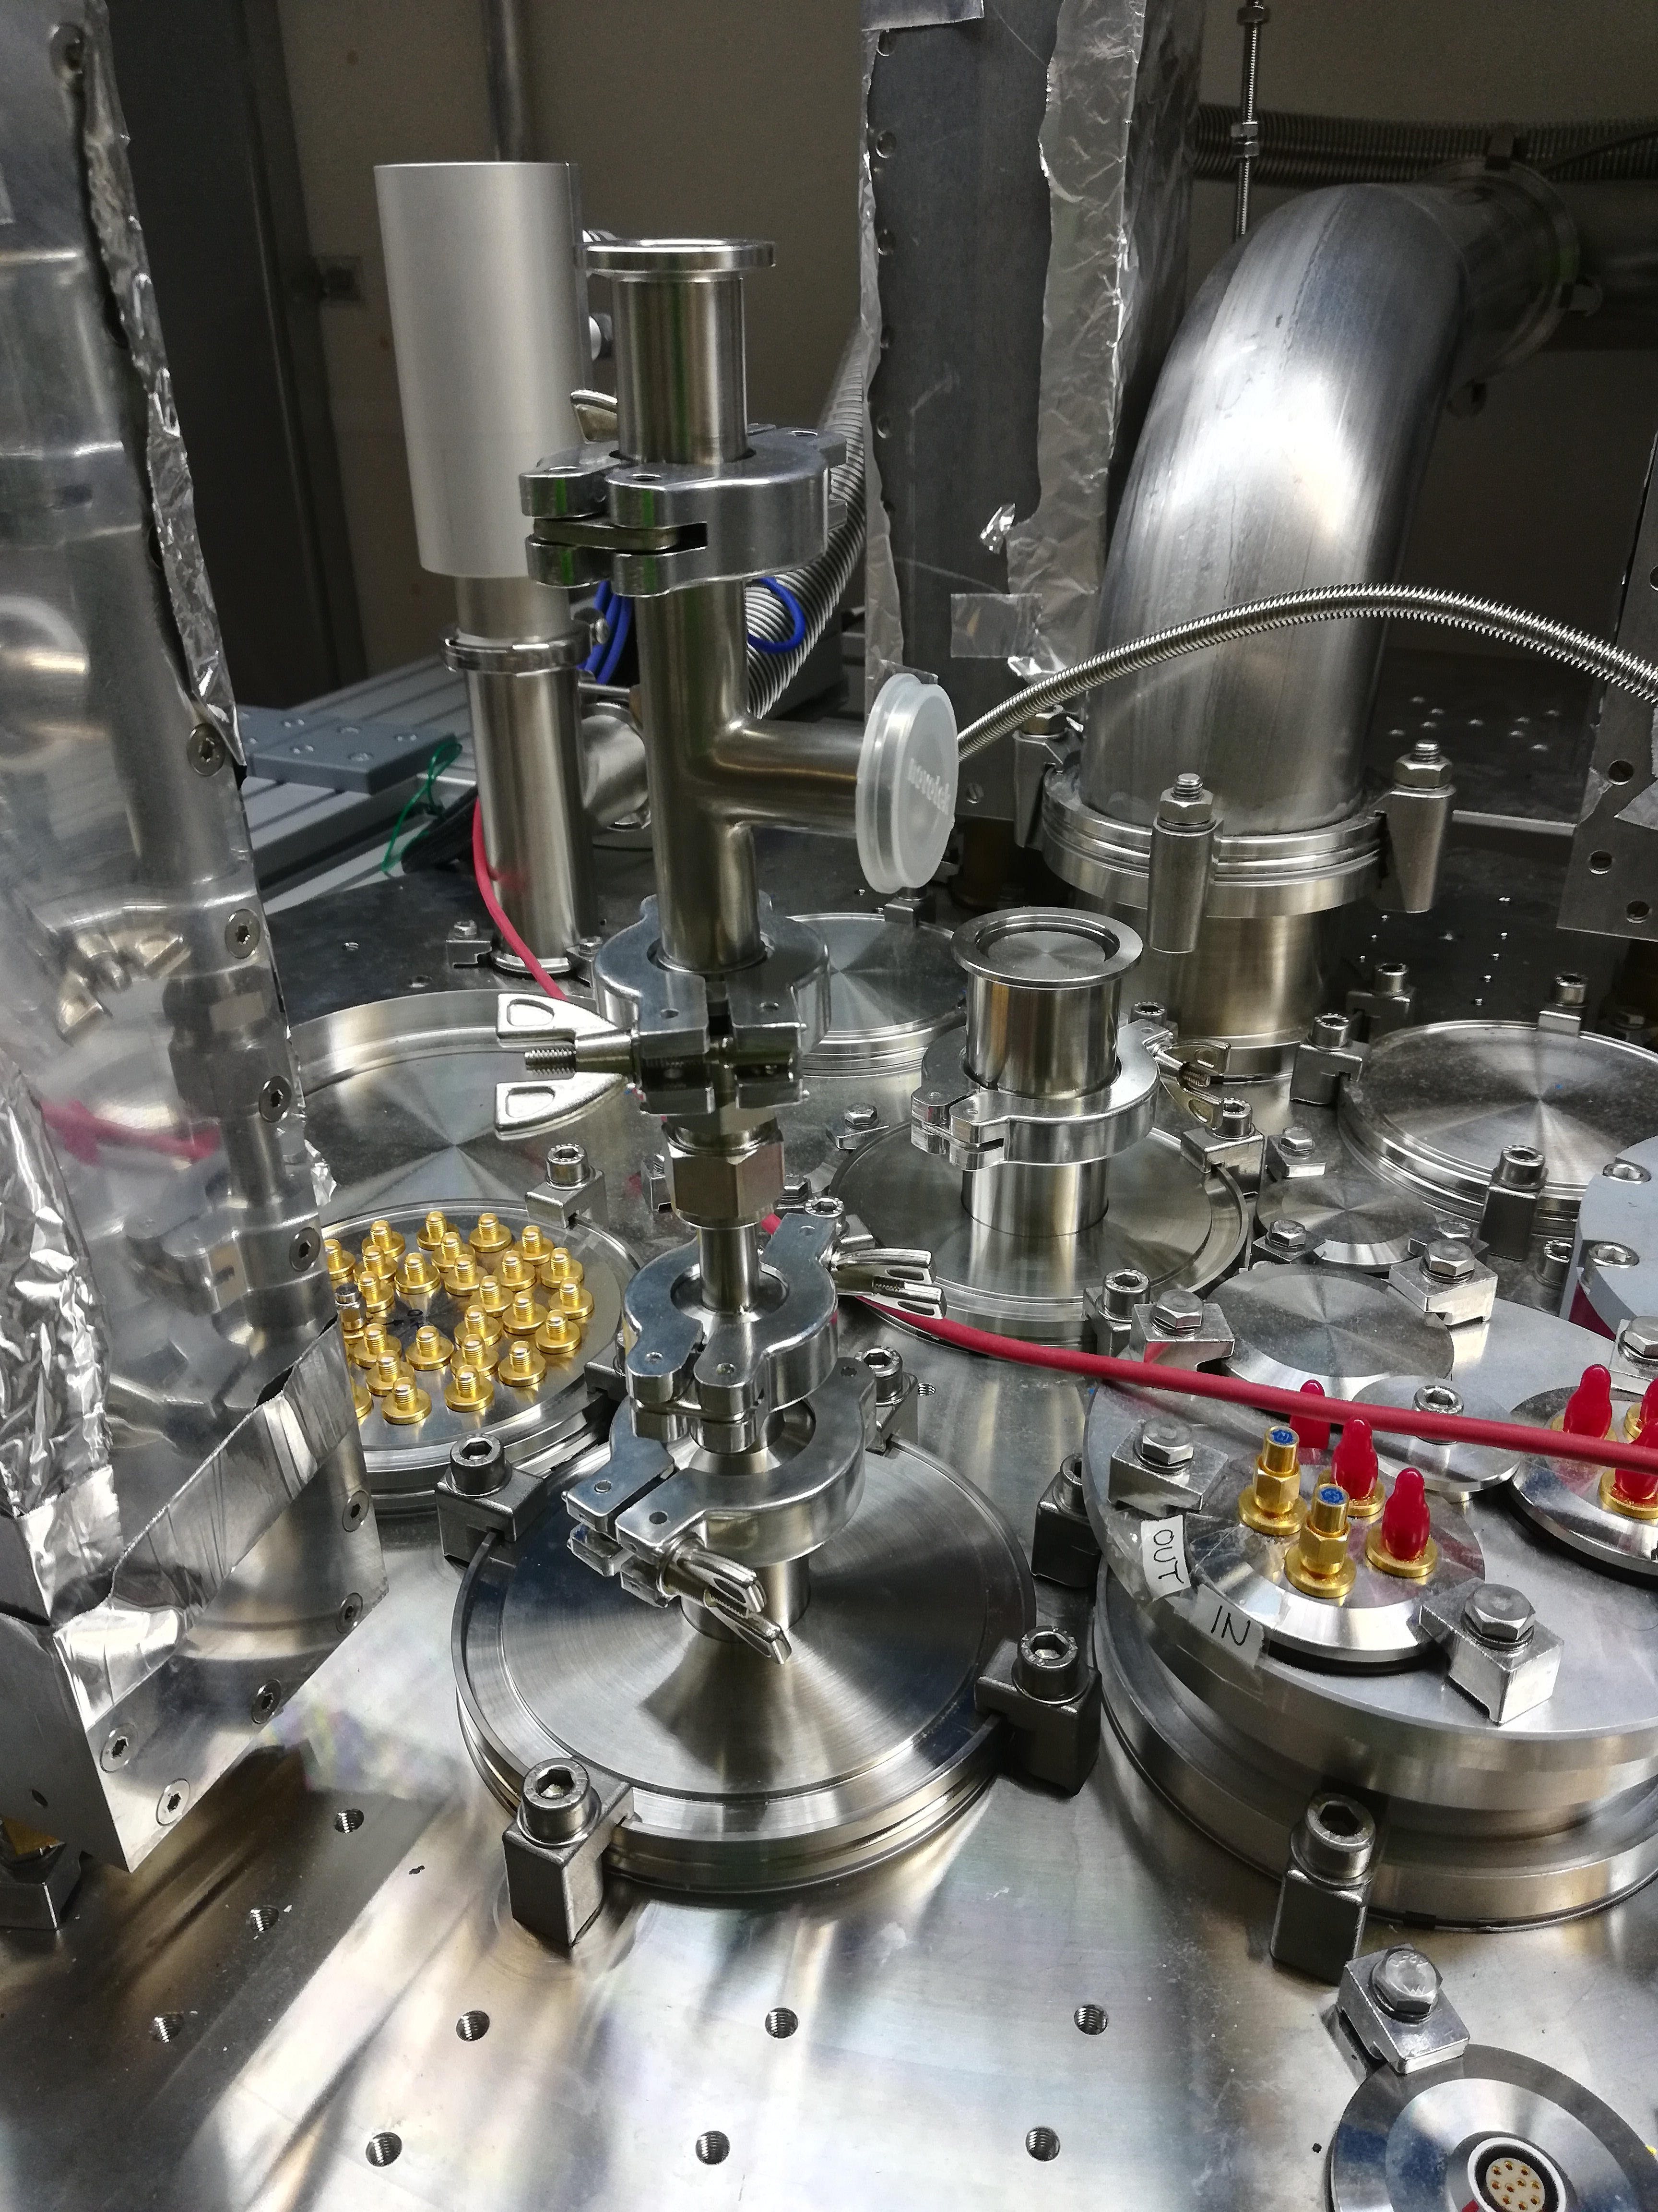

Slide 8
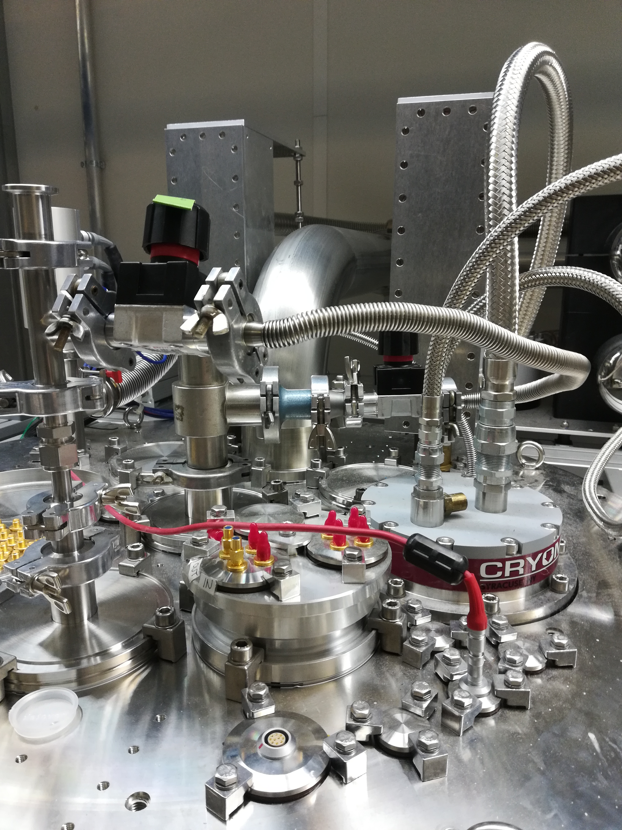

Slide 9
Level meter
outer tube
holes to improve fluid response
LC circuit
Coil on top of the cell
Outer tube and inner rod as the capacitor
Dielectric constant of rising liquid helium increases capacitance
Leads to change in resonance frequency
Can be seen with a network analyzer
inner rod

Slide 10
What's next ?
Put an MMC into the Proto-cell together with a heater
Test sensitivity of MMC in liquid helium
Check if phonons can be detected
Go to next larger cell
Test superconducting motors
Detection of UV-photons
Search for delayed triplet signal
….

